Slide 1
Tourism Marketing for small businesses
Chapter 1

Slide 2
Chapter learning aims
To enhance your understanding of:
the distinguishing characteristics of tourism services
the challenge of differentiating tourism services
the importance of a marketing orientation

Slide 3
Key terms
Tourism
Tourism is used as a generic descriptor, subsuming the many interrelated activities related to travel, holidays, hospitality, lodging, leisure, events, entertainment and recreation.
Differentiation
Standing out from competitors as being different, in the minds of consumers, on the basis of an attribute or benefit that is meaningful to them in the purchase situation.
Marketing orientation
An outward and forward thinking philosophy that dictates all marketing decision making is made with the interests of target consumers in mind.

Slide 4
Tourism Marketing for Small Businesses
99% of the world’s tourism businesses are small to medium sized enterprises
Small businesses and not-for-profits (eg Museums) operate with scarce resources
Small tourism businesses can’t follow the same marketing strategies as the big corporate travel brands

Slide 5
A bridge between theory and practise
The text focuses on how theory can be used in practical ways by small tourism businesses
There is nothing so practical as a good theory
  A good theory provides a substantiated explanation of some aspect of our world. This explanation clearly and succinctly defines the key concepts involved, and the relationships between them, in a way that enables us to observe and measure, and make predictions about the outcome of future actions.

Slide 6
Distinguishing characteristics of tourism services
The majority of commercial activities in the tourism industry are in the form of services.
It is important to recognise how the distinguishing characteristics of tourism services, relative to consumer products, have implications for the marketing planning process and the marketing mix.

Slide 7
Intangibility, risk and the critical role of consumer perceptions
The only physical evidence of a service we haven’t previously experienced will be in the form of the information source
So, the customer’s expectations can only be realised after purchasing and travelling to the service
The lack of physical evidence means the consumer can only base their purchase decision on the perceptions they hold in their mind about the alternative options

Slide 8
Intangibility, risk and the critical role of consumer perceptions
Another consequence for the consumer when purchasing an intangible service is perceived risk, and so an important part of tourism marketing is managing perceptions of risks:
  Financial risk
  Performance risk
  Physical risk
  Psychological risk
Remember, tourism activities are often discretionary spending

Slide 9
Video link
https://www.youtube.com/watch?v=qsgFCvb9G28

Slide 10
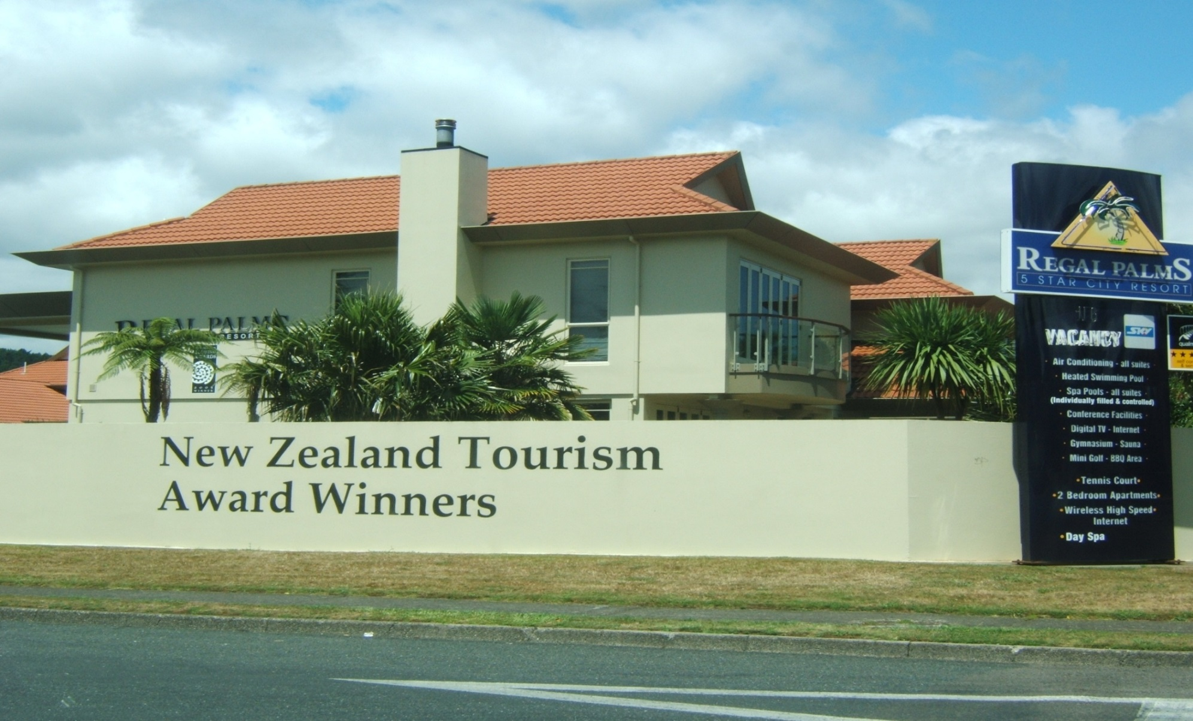
Tourism Awards – reduce the risk of intangibility to consumers

Slide 11
The role of people
The tourism provider and the customer have traditionally been inseparable in the delivery of the tourism service
Production and consumption occur more or less simultaneously
People have been required to make tourism services happen, and this means jobs for the community
While technological advances are leading to disruptions in the delivery of many tourism services, there will likely be limits to the extent that technology will replace human interaction, such as hotel robot concierges and driverless buses.
  In the short term people will continue to play a critical role in making most tourism services happen.

Slide 12
Activity 1.1 – A restaurant with no humans?
Would there be sufficient demand for a restaurant to provide this?
How interested would you be with such an experience?
What are the potential advantages and disadvantages for customers?

Slide 13
Variability of service quality
Perceptions of the quality of the service delivery can vary between customers
The same service person can vary their performance over the course of a shift or a week
Service delivery quality can also vary greatly between different staff
Even if we have previously enjoyed a particular tourism service, there is no guarantee the experience will be exactly the same next time

Slide 14
Perishability and seasonality
A tourism service experience can’t be stored for future use
Any unused capacity at the end of the day is considered perished because the potential cash flow has been lost
A major influence on perishability is seasonality. Seasonality represents fluctuations in demand over time, which can occur over the course of a day, a week, and between seasons during the year.
An implication of perishability and seasonality is the need for yield management, where pricing is flexible to match fluctuating demand levels.

Slide 15
The social stage setting
Many tourism services are performances acted out by suppliers and customers on a social stage
Whereas intangible services in many other sectors, such as financial services for example, take place in a private setting, travellers frequently share the experience with other guests
Issues that impact on appeal and satisfaction in this regard include: segregation of customer classes; congestion; experiences of the senses; making new friends; learning from others; and, the behaviour of other guests.

Slide 16
The challenge of differentiating tourism services
Tourism is fiercely competitive, for two key reasons.
  In most markets there are low barriers to entry for small business start-ups. In free markets, there are no rules dictating how many competing businesses are permitted to operate
  There is little if any legal protection from imitation of a good service idea. Really innovative tourism services emerge infrequently, and when they do they are quickly copied by competitors

Slide 17
Substitutability
It is difficult for small tourism businesses to gain a competitive edge in markets crowded with me too services, including larger corporates, offering similar features and benefits
In many purchase situations one tourism service brand is substitutable for another in the mind of the consumer
When brands are easily substitutable they are commodities that can only compete on price and volume

Slide 18
Cooperating to compete
Small tourism businesses have much to gain from working cooperatively with other local businesses by sharing promotional resources and creating a bigger impact in the marketplace than they could individually
Case 1.1 Austin’s Arts et Metiers Hotel, Paris
  How could the hotel collaborate with nearby businesses, in a mutually beneficial way, to stimulate new customers?

Slide 19
Marketing orientation
The key challenge facing tourism businesses in the current competitive environment is to effectively cut through the clutter of competition and differentiate in the minds of consumers at the time a purchase choice is being considered.
A marketing orientation is an outward and forward thinking philosophy of making decisions with the needs of the target consumer in mind.

Slide 20
Discussion questions
Why does tourism represent discretionary spending for many consumers?
Why do consumers’ perceptions play such an important role in tourism marketing?
Why is differentiation in the market place so challenging for small tourism businesses?

